Slide 1



Creators’ earnings and contracts
Copyright in the Digital Environment
Amy Thomas
18 March 2026

Slide 2
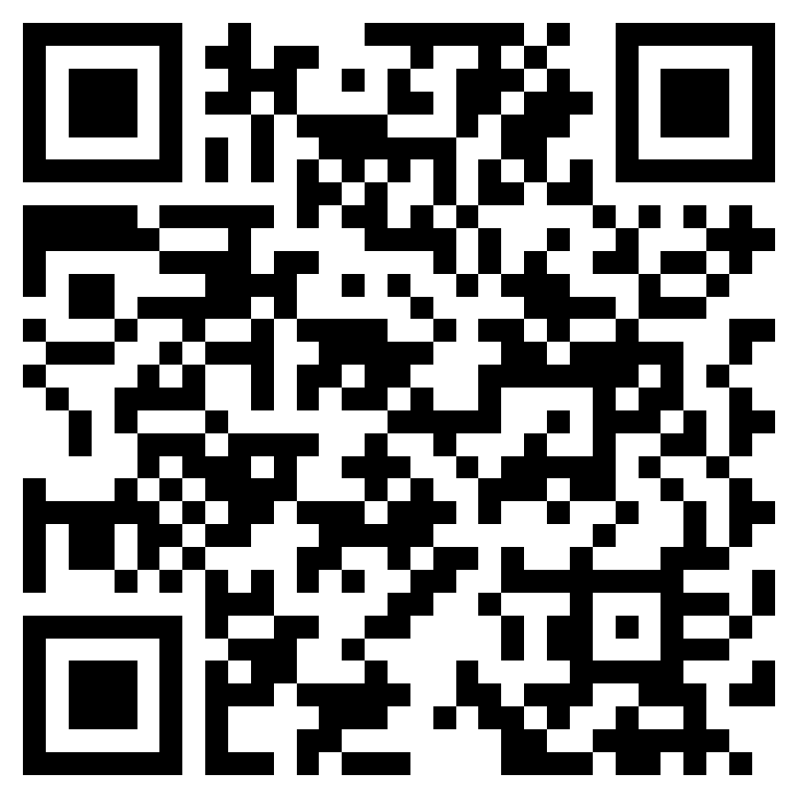
A wee favour…
Student consultation for new proposed course: Games and the Law
Estimated student intake - between 10 - 20 (specialist)
While the course primarily considers IP and tech law, it also includes competition, consumer protection, privacy, and labour law, as areas relevant for the regulation of games.
Proposed topics: legal history and development of games; game preservation and TPMs; XR/VR/Metaverse regulation; regulation of UGC; eSports and competitive gaming; game industry labour dynamics; game platform content moderation; dark patterns in games.
Assessment: The course is assessed by (a) an essay of 3,500 words (75%) - or multimedia equivalent, such as a video report, (b) a blog post of 1,500 words (25%) on an emerging topic of regulation in games.
https://forms.cloud.microsoft/e/JH9AhBRtCL

Slide 3
Format: 18 March
Contracts: how is copyright monetised?
Earnings: is our current system effective?

Slide 4
Copyright holder (author, performer, artist, heir etc.)
We’re looking at these
Exploitation contract
Intermediaries (publishers, distributors, adaptors, agents, collectives, platforms etc.)
Market prices, licensing contracts
Final users (consumers, broadcasters, other performers, libraries etc.)

Slide 5
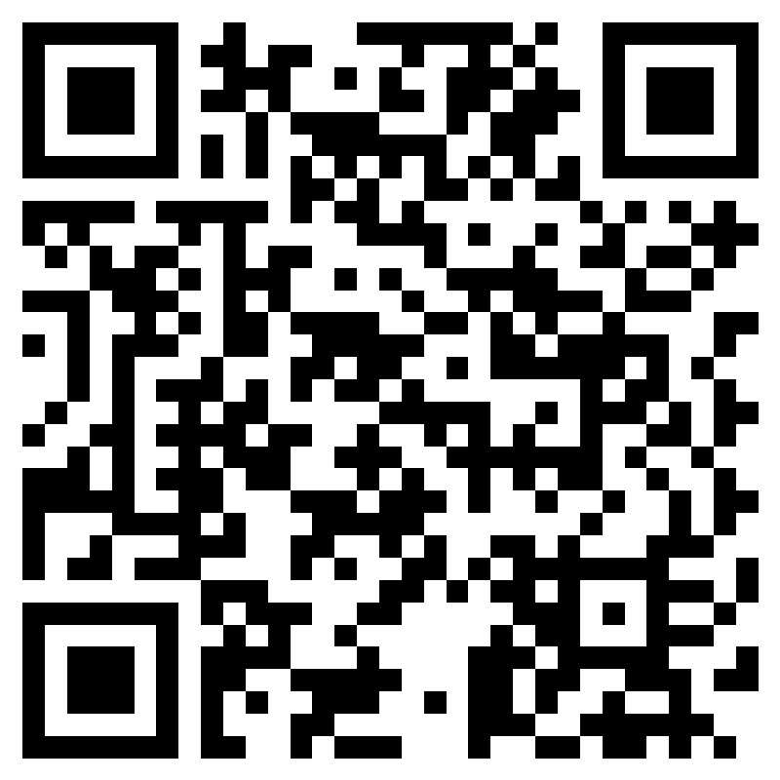
Is copyright a ‘right to get paid’?
Does having a copyright mean you deserve to be paid fairly when someone else uses your work? What factors would affect your opinion?
https://forms.cloud.microsoft/e/kvA5P0Wb6B

Slide 6
Is copyright a ‘right to get paid’?
A bigger policy question: is money needed to incentivise people to create?
What is the quality of the thing?
Note: principle of aesthetic neutrality in copyright means the right itself isn’t always a hallmark of ‘quality’
How effectively were you able to leverage it on the market? Recall: Spotify example – independent vs ‘traditional’ route
Role of intermediaries (publishers, platforms etc.)

Slide 7
Contracts
How do creators make money?
Thomas Babington (Lord) Macaulay argued in the House of Commons (5 February 1841): “...there are only two ways in which [men of letters] can be remunerated. One of those is patronage; the other is copyright.”
Copyright: is a negative right that means works can be made available subject to certain conditions (e.g., pay me!); and those conditions are often set through contracts

Slide 8

Contract review
Imagine you’re reviewing this contract for a client you’re representing. Have a look and identify:
Who ‘owns’ the work?
What kinds of things can the publisher do with the work?
How is your client going to get paid?
How will the contract be brought to an end? Can the client terminate it if they’re unhappy?
Are there any other terms you think are unfair/illegal/strange?
Important: if you feel bamboozled by this that’s the point!
Find me on Moodle

Slide 9
Ownership
Is the work licenced or assigned?
Assignation
Equivalent of sale
Requirement of form: assignations must be in writing
Licences
Equivalent of lease
Licences are limited in time and purpose
Exclusive or non-exclusive

Slide 10
Scope of rights
What rights have been assigned and over what mediums?
Economic rights
Incl., reproduction, distribution, translation, adaptation, communication to the public (need for extensive grab? The TV show soundtrack problem)
Consider: does the creator own all the rights they say they do? Has the work been made in the course of employment or commissioned? Authorship ≠ ownership
Moral rights
Paternity (attribution) and integrity (objection to derogatory treatment)
In the UK, moral rights can be waived but not licensed or assigned
Right to attribution must be asserted
Waivers must be in writing

Slide 11
Remuneration
How will you get paid (consideration)? Note: usually not a salary!
Advances (up-front)
Lump-sum offered ahead of completion of the work
Buy-outs (up-front)
Single, lump-sum payment with no associated future payments
Royalties/residuals (future payments)
Percentage payments offered usually as figure of net receipts or profits from the publisher
May be specific to medium (e.g., different from hard back vs paper back vs eBook)

Slide 12
Revision/termination
How will the contract be brought to an end and by which party?
Reversion and revocation rights
Bounded by time (e.g., after 10 years)
Triggered by activity (e.g., publisher isn’t promoting the work)
Can the contract be transferred to a third party?

Slide 13
Contract review
Assume this contract is non-negotiable/boilerplate/agree-or-walk-away: do you think the contract is fair? Would you advise your client to sign it? What factors would affect your opinion?

Slide 14
Contracts: the reality
Creator
No information about the market (how will my work perform? Where should I distribute it?)
No up front capital to start the exploitation and future payments uncertain
Risks
Incentives
Bargaining power
Unequal access to information
Publisher
No guarantee that work will perform well (markets are unpredictable)

Slide 15
Contracts: the reality
Creator
No information about the market (how will my work perform? Where should I distribute it?)
No up front capital to start the exploitation and future payments uncertain
Risks
Incentives
Bargaining power
Unequal access to information
Publisher
No guarantee that work will perform well (markets are unpredictable)
Usually the ‘weaker’ party

Slide 16
Freedom of contract
UK (and US) emphasise freedom of contract: efficiency, certainty, flexibility
In the UK, copyright isn’t the same as a right to get paid – it creates the opportunity to get paid
Many other countries emphasise creators’ vulnerability and have in-built legal protections to curtail exploitation. See especially continental Europe:
Most countries have affirmative image rights (note: overlap with performers’ rights)
Copyright in the Digital Single Market Directive 2019, Chapter 3 (Arts 18 – 22) (note: doesn’t apply in the UK)
Mandatory revocation right (Article 22)
Transparency obligations (Article 19)
Right to ‘appropriate and proportionate remuneration’ (Article 18)

Slide 17
Freedom of contract
Most cases settle: Spakowski/CD Projekt Red (The Witcher); Solomon Linda’s estate/Disney (‘The Lion Sleeps Tonight’); The Stone Roses/Silvertone
Elton John v Dick James [1985] (settled): it was a “hard bargain, but it would be unjust now to set aside”
Fisher v Brooker [2009] UKHL 41: (Lord Hope’s opinion) the point of copyright is to ”incentivise innovation and creativity” and because Fisher's contribution made the song such a success, he was entitled to "protect the advantage that he has gained from this and to earn his reward” <- public policy reasons to interpret the contract in a certain way

Slide 18
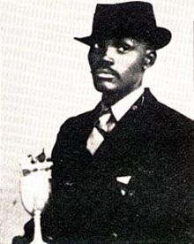
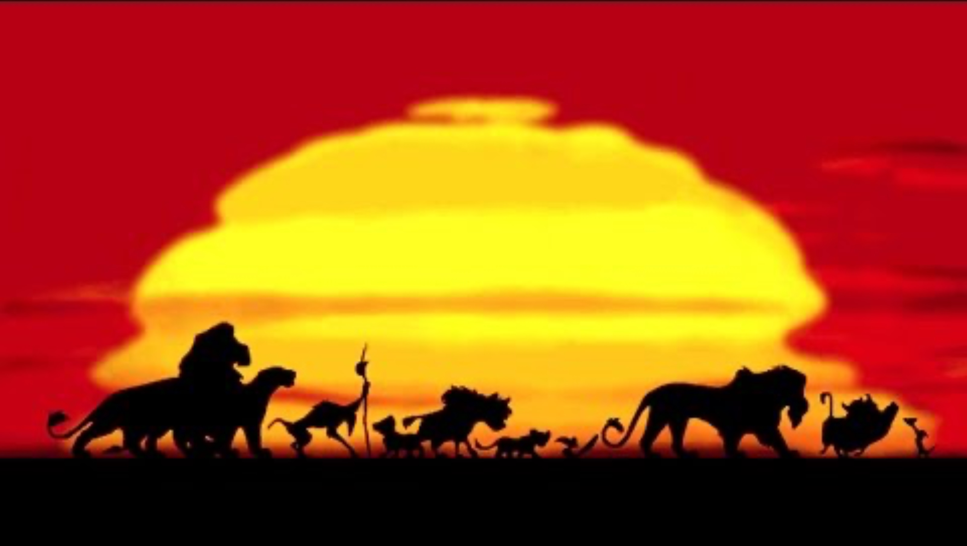
Limited reversion
Griesel NO v Walt Disney Enterprises Inc and others: case withdrawn (South Africa)
Solomon Linda - Mbube - sold to Gallo Record Company for 10 shillings
Pete Seeger – Wimoweh – owned by Folkways, asked for assignment of Linda’s wife’s rights for one dollar, then assigned again to Abilene Music (for another dollar)
George Weiss, Hugo Peretti and Luigi Creatore – The Lion Sleeps Tonight

Slide 19
Limited reversion
Obscure reversionary provision in the 1911 Imperial Copyright Act: 25 years after the author’s death, copyright reverts to the executor of the author’s estate, notwithstanding any assignations – so the transfer from wife/daughters legally ineffective as rights vested with the executor (nemo dat quod non habet)
The Linda heirs will receive payment for past uses of The Lion Sleeps Tonight and an entitlement to future royalties from its worldwide use.
The Lion Sleeps Tonight is acknowledged as derived from Mbube.
Solomon Linda is acknowledged as a co-composer of The Lion Sleeps Tonight and will be designated as such in the future.
Any benefactors of older (assigned) works in former British empire could benefit from this provision

Slide 20
Limited equitable remuneration
Remember: limited equitable remuneration rights
182D CDPA implementing the Rome Convention and (EU) Rental Directive:
(1)Where a commercially published sound recording of the whole or any substantial part of a qualifying performance—
(a) is played in public, or
(b) is communicated to the public […]
the performer is entitled to equitable remuneration from the owner of the copyright in the sound recording
(2)The right to equitable remuneration under this section may not be assigned by the performer except to a collecting society [usually Performing Rights Society (PRS) and Phonographic Performance Limited (PPL)] for the purpose of enabling it to enforce the right on his behalf.

Slide 21
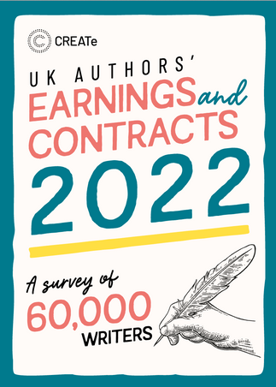
Contracts and fair remuneration: the reality
Context: socio-legal, empirical research – law in action/reality
Large-scale surveys and interviews with creators in the UK
Focussing on ‘serious’ creators (registered with a collecting society, spending more than 50% of their time on their creative work)
Authors (traditional and indie); audiovisual actors; directors; journalists, and; visual artists.

Slide 22
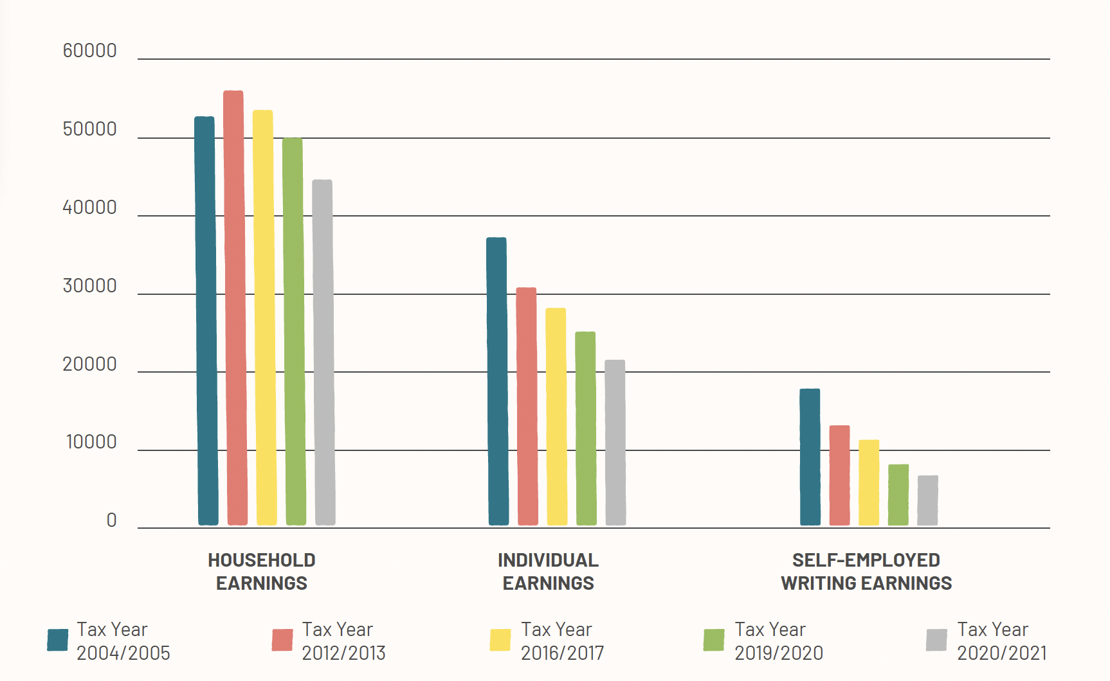
Contracts and fair remuneration: the reality
Most creators don’t earn most of their income from copyright sources
… and most creators can’t earn a living from their creative work alone (less than minimum wage)
Role of the ‘day job’ or a ‘household subsidy’

Slide 23
Contracts and fair remuneration: the reality
 | Directors | Journalists | Actors | Visual Artists | Indie Authors | Traditional Authors
Annual Median Earnings from creative work | £55,000 | £17,500 | £17,500 | £12,500 | £9,375 | £7,000

Slide 24
Contracts and fair remuneration: the reality
A small number of creators earn a disproportionate amount of the money – ‘winner-take-all’
Source: ALCS Survey, UK authors’ income (gross)

Slide 25
Contracts and fair remuneration: the reality
Creators don’t understand contracts (’legalese’) and may not have the resources to hire legal help to negotiate them
‘Agree or walk away/take it or leave it’
Agents and collective bargaining play a mitigating role:
During the last 5 years, did you or your agent attempt to change the terms of a contract you were offered?
Performers – 56.2% tried, and 89.4% succeeded
Authors – 32% tried, and 28% succeeded
“How confident are you in your knowledge of copyright/statutory rights?”
Performers: mostly very little confidence (30.7%)
Authors: mostly moderately confident (56%) <- but confidently incorrect!

Slide 26
The consequences: declining supply?

Slide 27
The consequences: a lack of diversity?
Most creators are from a socio-economic background associated with the highest levels of privilege

Slide 28
The consequences: a lack of diversity?
Patterns of inequality still exist, see e.g., the gender pay gap
 | Men | Women
Visual Artists | £12,500 | £7,500
Directors | £55,000 | £45,000
Authors | £29,000 | £1700
Actors | £17,500 | £17,500
Journalists | £17,500 | £18,000
Indie Authors | £9985 | £14,989
 | Men (authors) | Women (authors)
2018 | £32,377 | £21,585
2019 | £29,340 | £18,441
2020 | £29,000 | £17,000

Slide 29
Policy implications
Sustainability of the writing profession (who can afford to participate)
Diversity of cultural production (who gets to participate)
Based on the findings of this report, what policy solutions, if any, would you propose to help creators?

Slide 30
Summary
Be aware that copyright is just one way that creators can get paid
Creators are often the less powerful party in contractual negotiations (and in the UK, there is little legal remedy/protection for this)
Creative industries are skewed: creators are often paid very little, but intermediaries are no less wealthy – where is the money going?

Slide 31
Side note: Remuneration without contract
Just because something isn’t protected doesn’t mean people can’t make money (bundle it in a contract and sell it anyway):
Image rights (Proactive Sports Management v Rooney): “image rights should be fully realisable for this economic purpose” (restraint of trade)
IP ‘negative spaces’ – creative areas where formalised IP protection is either impossible or actively harmful: see fashion, TV formats etc.

Slide 32
Side note: Freedom to contract away
And sometimes rights protection/seeking money would negatively impact the activity
Freedom of contract means you can also choose to ‘freely’ give it away
Are there any property rights in Wikipedia?
Why isn’t Wikipedia monetised?

Slide 33
Side note: Freedom to contract away
There are definitely property rights: in the underlying literary work (the text itself), artistic works (graphics, visuals) and structure of the database itself
An ‘open’ philosophy or opposition to treating knowledge as proprietary
Practical considerations: how to attribute collaborators? What if someone wants to withdraw their contribution? How do we manage rights simultaneously across jurisdictions?
Take a look at this paper: https://zenodo.org/records/16883055
What does the author let you do with their work? Do they have any conditions on how you can use it?

Slide 34
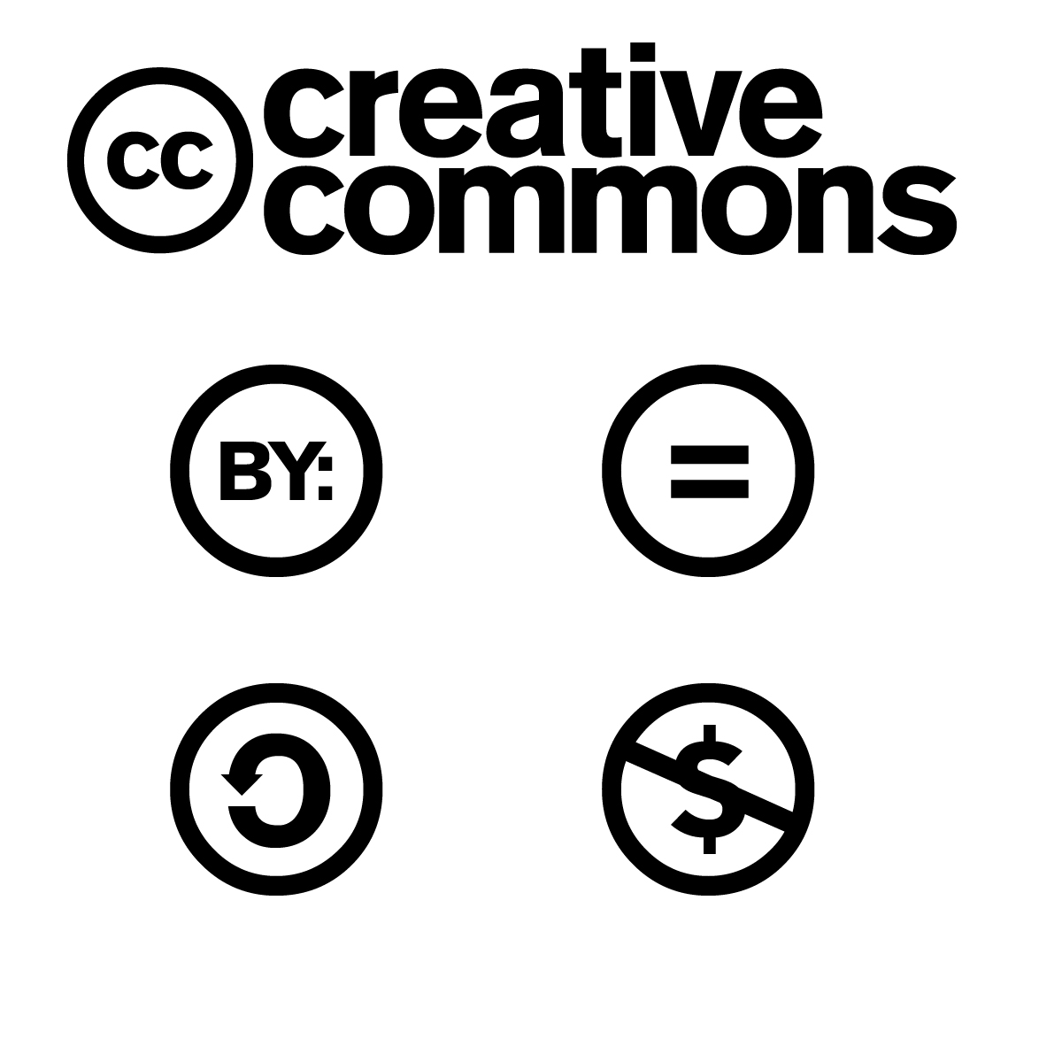
Side note: Freedom to contract away
‘Open’ licences give others permission to share, use, and build upon their work under specific conditions:
Creative Commons: Attribution (BY), ShareAlike (SA), NoDerivatives (ND), and NonCommercial (NC), Zero (0)
Open Software – e.g., General Public Licence (GNU)
Freedom to contract also means you can agree to be more liberal than the default copyright regime – consider e.g., unwaivable moral rights

Slide 35
Next week
Office hours: please email me to arrange a time: amy.thomas@glasgow.ac.uk
Next session: Essay preparation/revision (25 March)
Please send any specific/technical questions you would like me to consider no later than Tuesday 25 March 12 noon
Note: ahead of the revision session, you will receive feedback for your formative assessments

